Slide 1
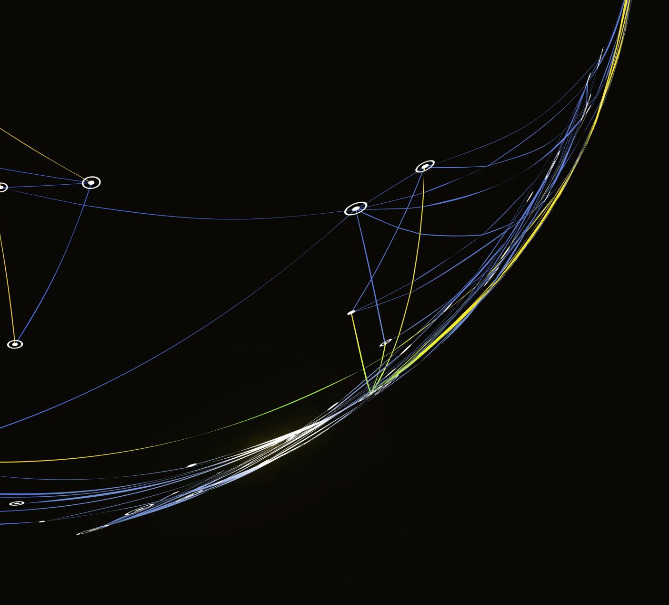
AIML CA1 Part A
LIM JUN YI DAAA/1B/FT/03

Slide 2
Aim of the assignment (Part A)
This is a classification problem
To build a machine learning model to predict water quality based on the water properties
Using the “CA1-Classification-Dataset.csv”

Slide 3
Entire Machine Learning Process
Preprocessing data
Train-test split
Training and tuning models
Evaluating the results
Duplicates
Impute
Outliers
- Obtaining 2 train-test split: one is using the filtered df, the other is using the original df.
- Scaling of the different X_trains
- Training and comparing which X_train is the best to train and test the model
- Tuning the model and obtain the tuned results
- Find out which is the best model
- Create a dummy baseline to compare the best model
- Fit and predict with final model
- Evaluate the final score

Slide 4
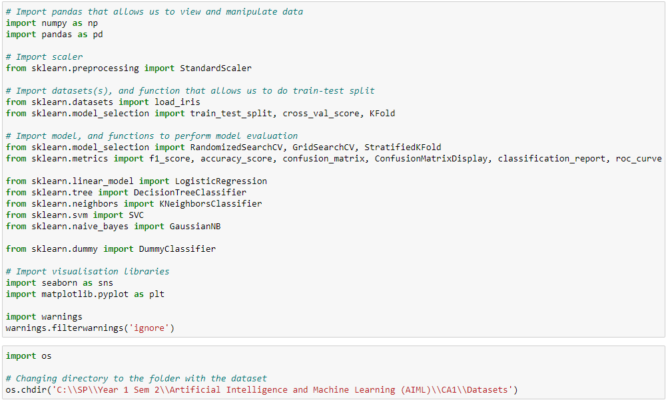
Importing Functions
Step 0: Importing Required Functions
Importing required functions
Changing directory to where the dataset is

Slide 5
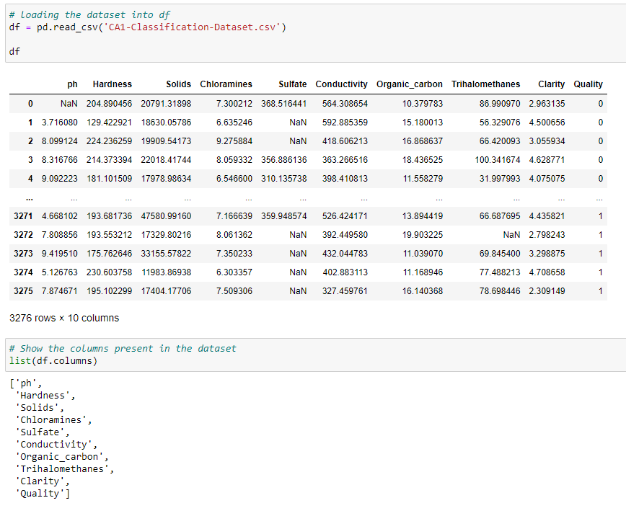
Loading data
Step 1: Preprocessing data
Loading and visualizing the data
Naming columns present in the data

Slide 6
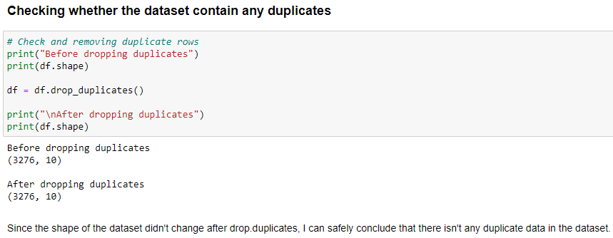
Removing Duplicates
1. Since the shape of the dataset didn’t change after drop_duplicates(), I can conclude that the dataset doesn’t contain any duplicates.

Slide 7
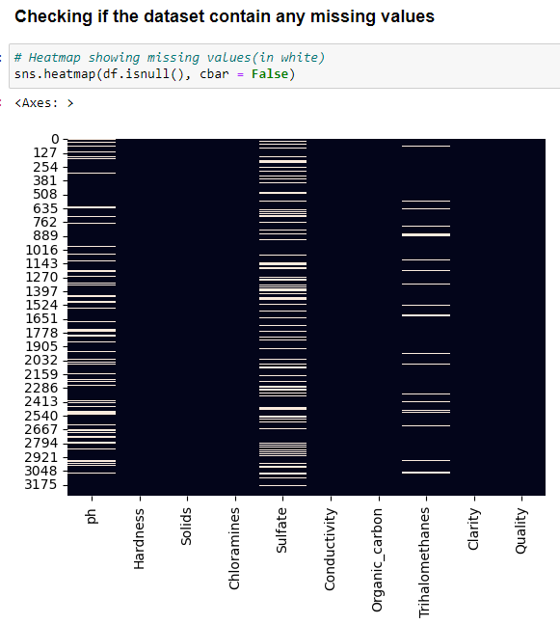
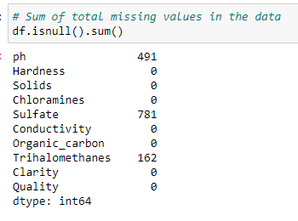
Check for missing values
Plotting a heatmap to visualize whether the data contain missing values (white lines → missing values)
Showing total number of missing values in the data

Slide 8
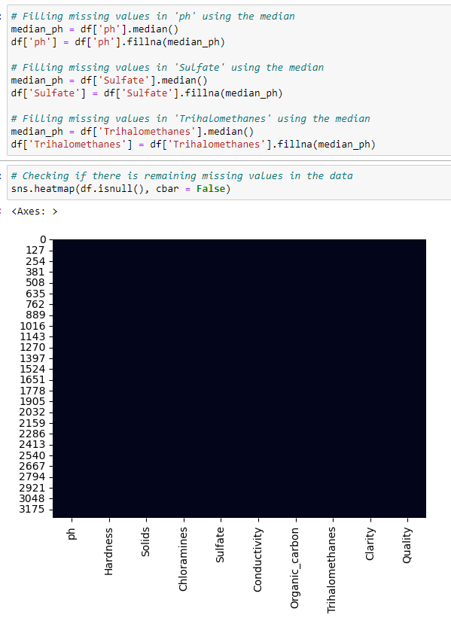
Imputing missing values
Decided to use median of each features to impute the missing values → as median doesn’t get affected by outliers of the data
Plotting a heatmap to check whether there are still missing values (All black = no missing values)

Slide 9
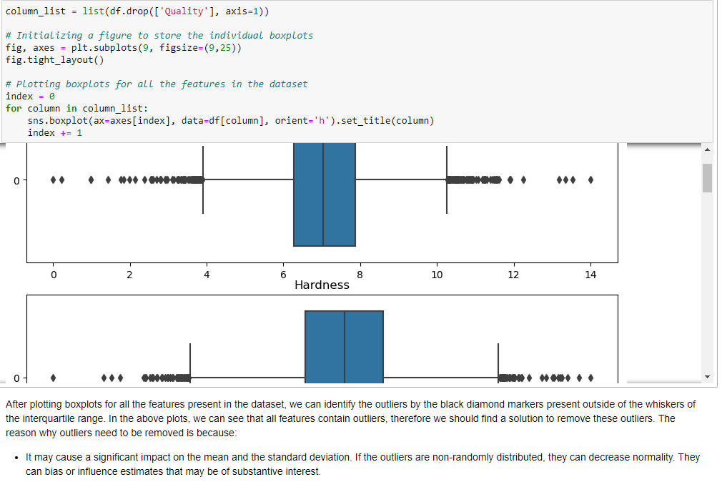
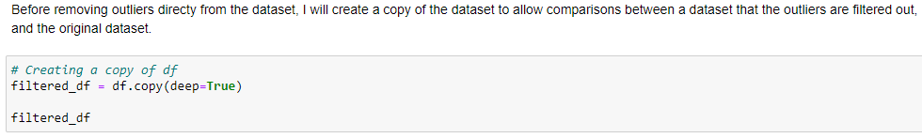
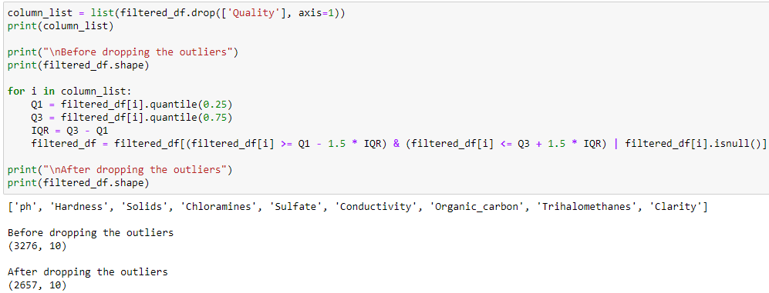
Check & Remove outliers
Plotting boxplots for each features to see whether they contain any outliers (black markers outside the First and Fourth Quarters are outliers)
Making a new copy of df (filtered_df) to allow comparison when training the model
Putting the formula to remove outliers into a for loop and running it through all features

Slide 10
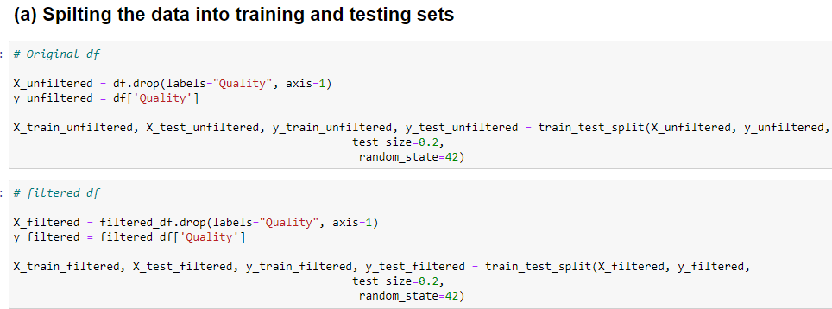
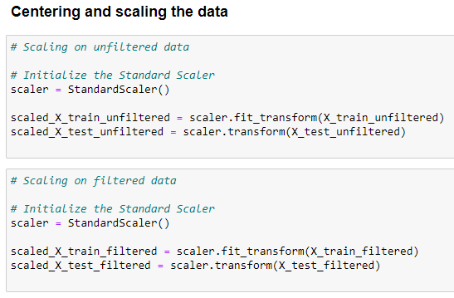
Train-test Split
Step 2: Train-Test Split
Creating 2 train-test split, one is with the original df, the other is with filtered_df which is without outliers.
Standardisation (Scaling) of data
Now I have 4 different X_trains:
X_train_unfiltered, scaled_X_train_unfiltered,
X_train_filtered, scaled_X_train_filtered

Slide 11
Process of training & tuning the models
Step 3: Training + Tuning of Models
I will be using f1_weighted as the scoring, as there seems to be an imbalance of data for the quality columns (target). Thus, if I would to use the normal f1 or accuracy, it may not be a good representative of the models’ capabilities to predict.
Process of training + Tuning
1. Use Cross Validation on 4 different X_trains for each model and see which produces the best results
2. Tune the model
3. Use Cross Validation (again) to produce the best results of the models to compare

Slide 12
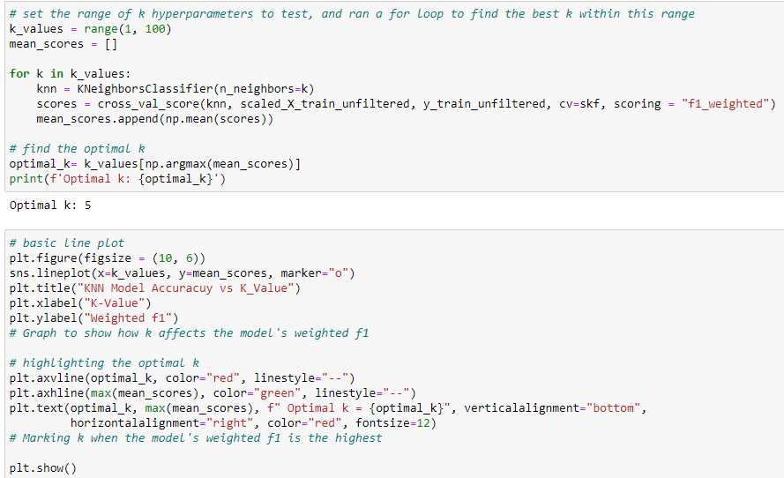
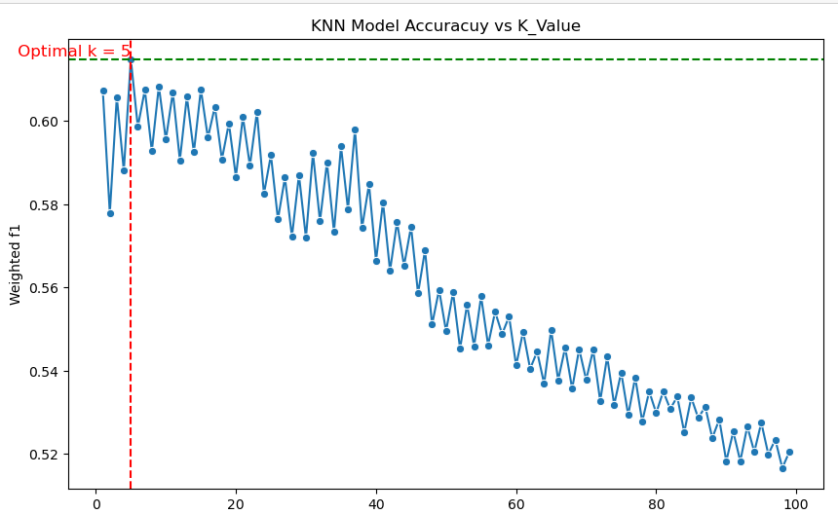
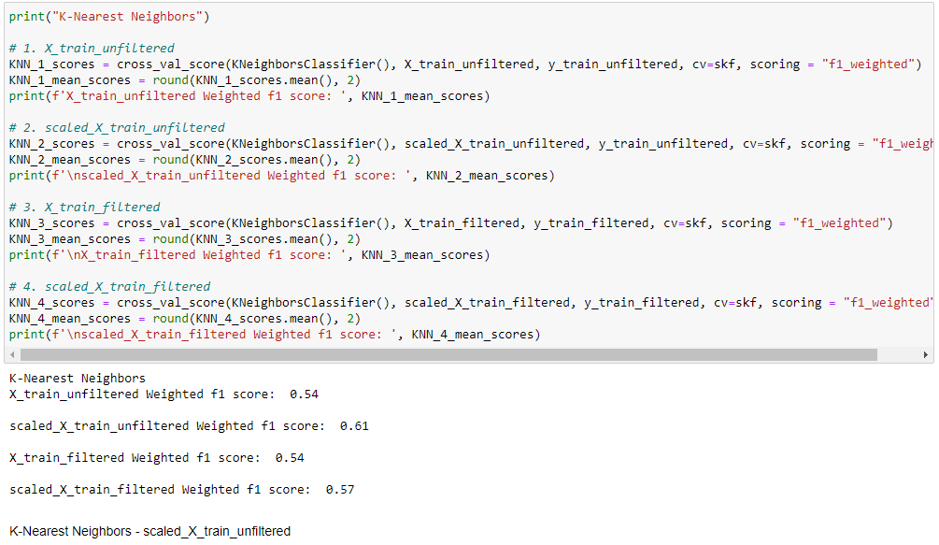
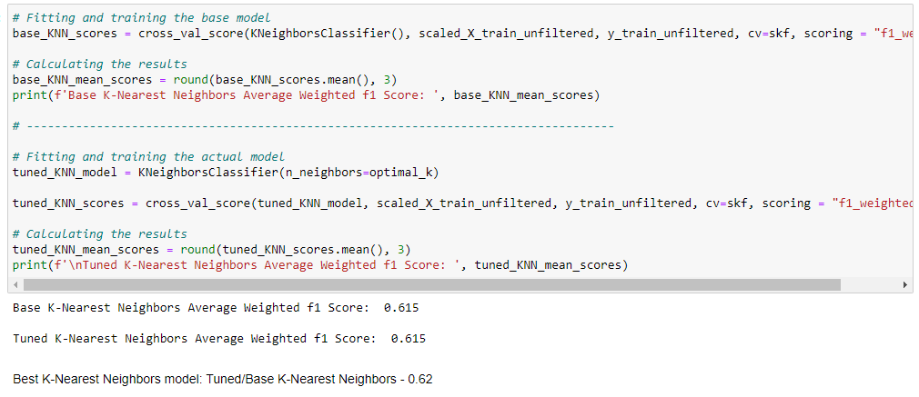
K-nearest neighbors
2.
Find out which X_train produces the best results for KNN
Tune hyperparameters of KNN
Compare the based and tuned KNN models to see which one is better
1.
3.

Slide 13
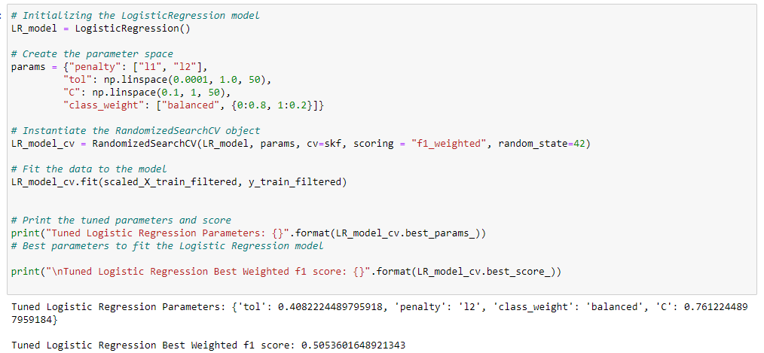
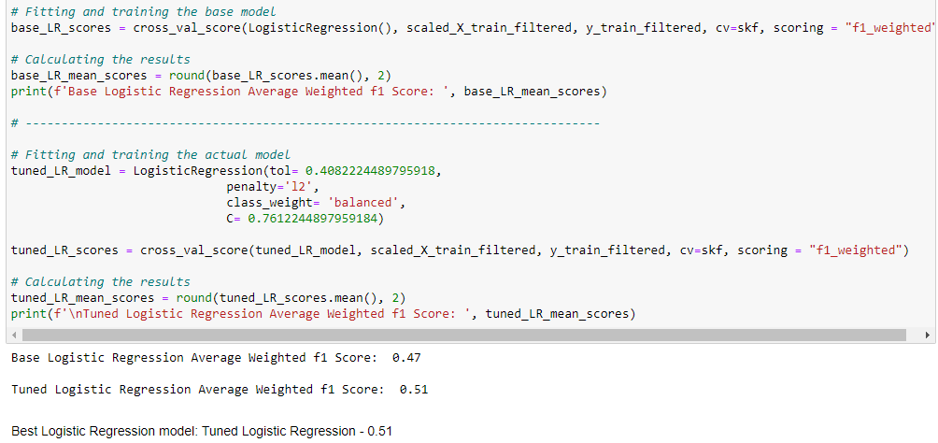
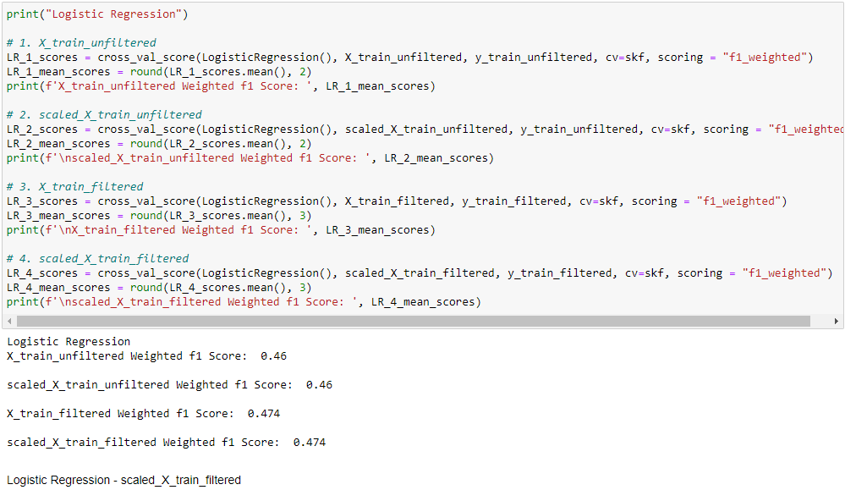
Logistic regression
2.
Find out which X_train produces the best results for Logistic Regression
Tune hyperparameters of Logistic Regression
Compare the based and tuned Logistic Regression models to see which one is better
3.
1.

Slide 14
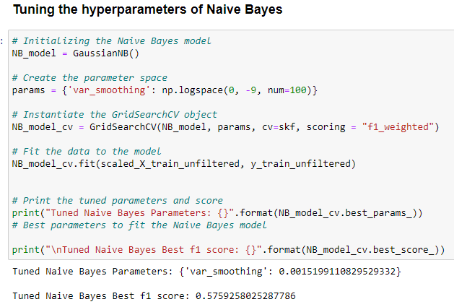
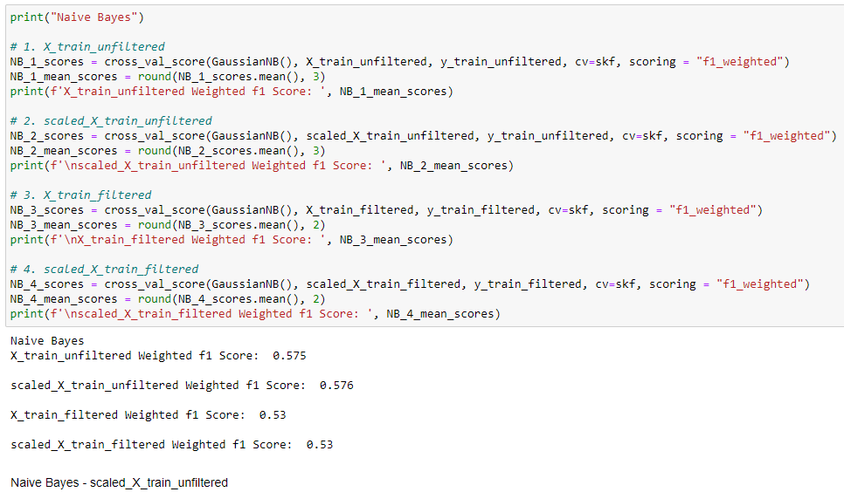
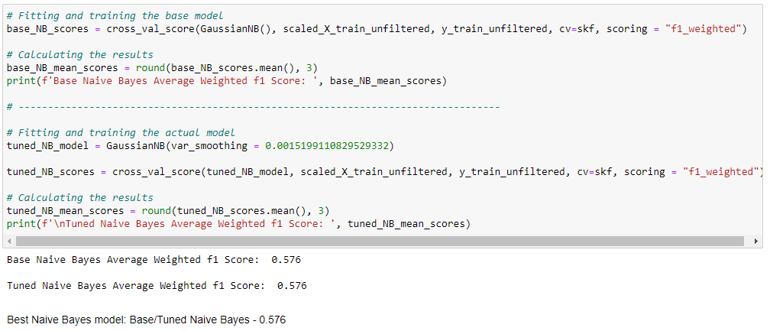
Naïve Bayes
2.
Find out which X_train produces the best results for Naïve Bayes
Tune hyperparameters of Naïve Bayes
Compare the based and tuned Naïve Bayes models to see which one is better
1.
3.

Slide 15
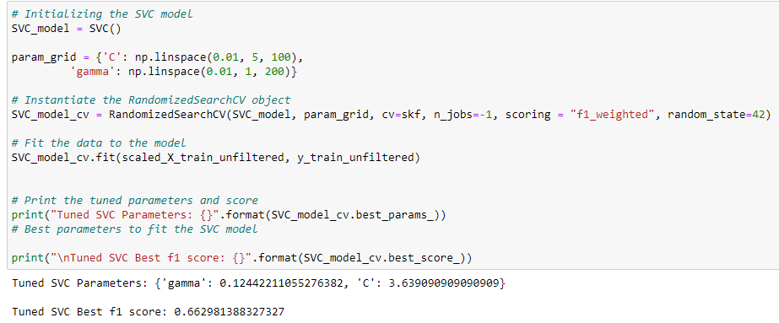
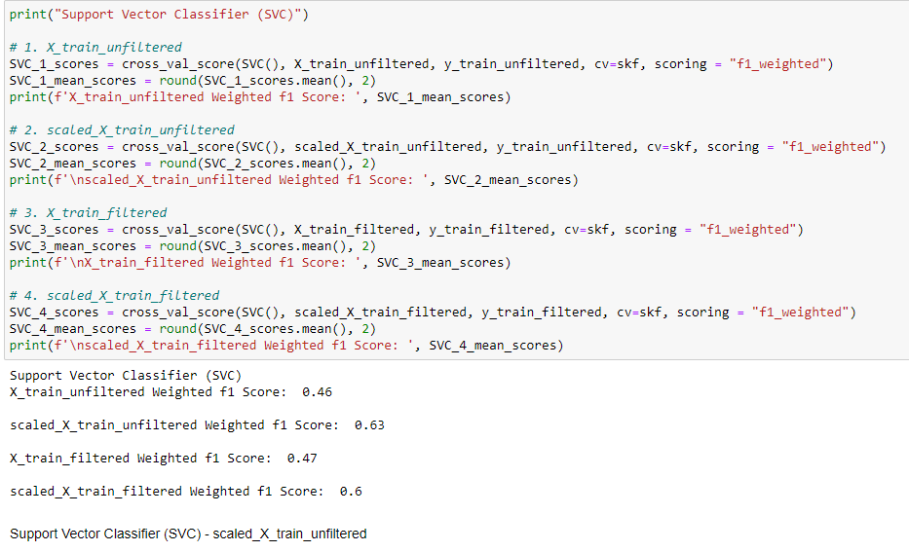
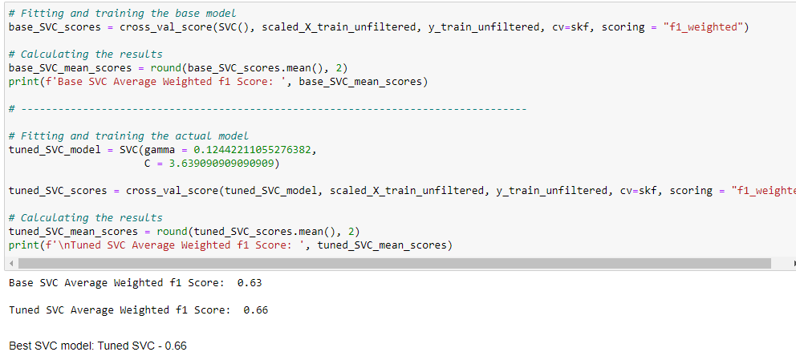
Support vector classification (SVC)
2.
Find out which X_train produces the best results for SVC
Tune hyperparameters of SVC
Compare the based and tuned SVC models to see which one is better
1.
3.

Slide 16
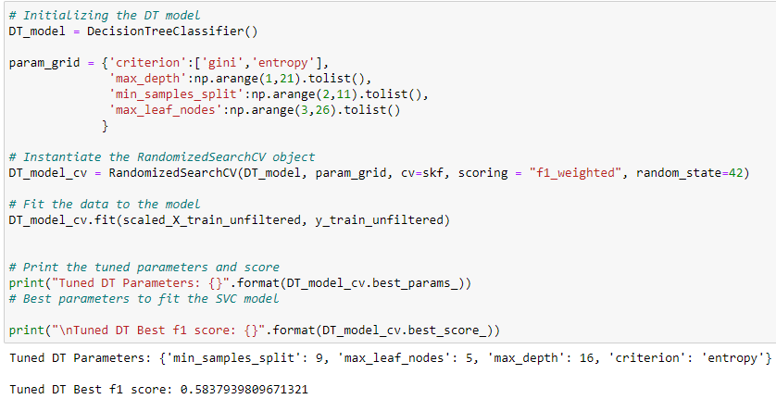
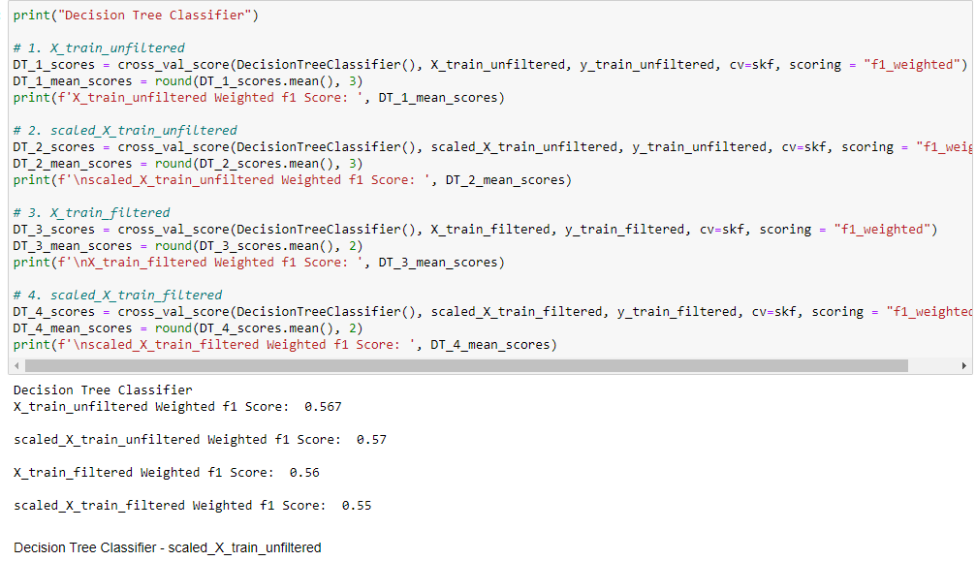
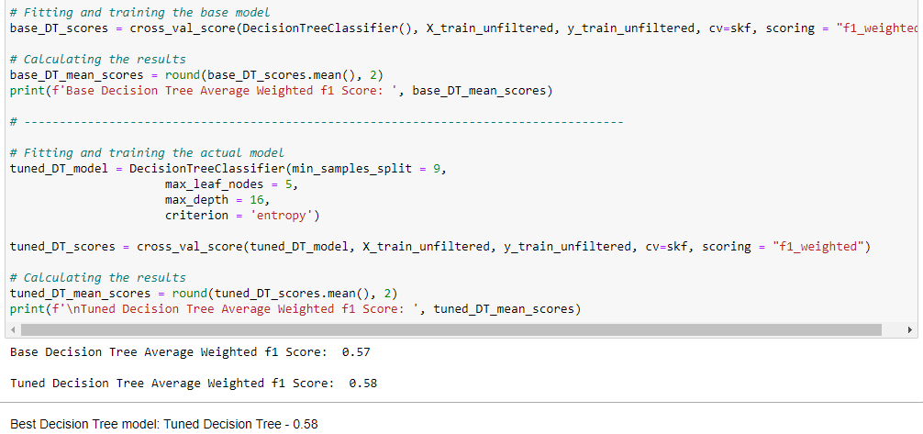
Decision tree classifier
2.
Find out which X_train produces the best results for Decision tree
Tune hyperparameters of Decision tree
Compare the based and tuned Decision tree models to see which one is better
1.
3.

Slide 17
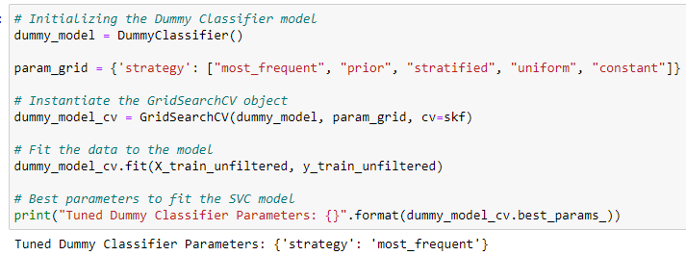
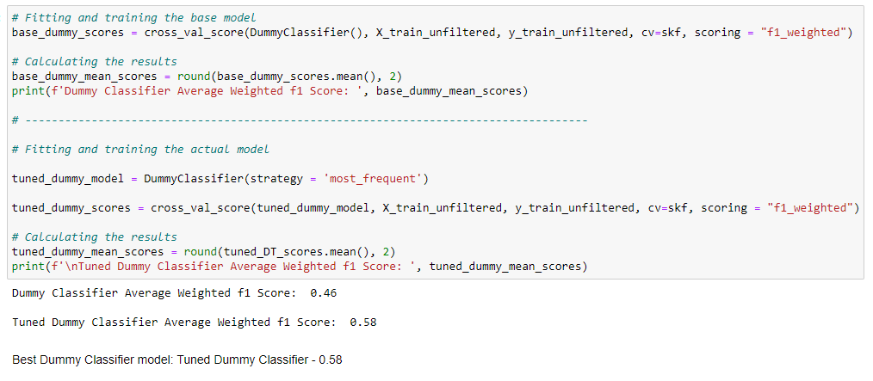
Dummy classifier
2.
Train Dummy Classifier with X_train_unfiltered (Simulate how the model will perform without any adjustments
Tune the hyperparameters of Dummy Classifier model
Compare the based and tuned Dummy models to see which one is better
3.

Slide 18
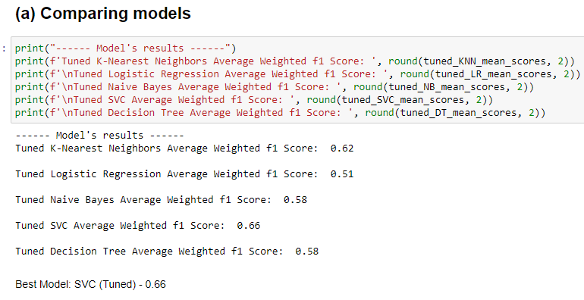
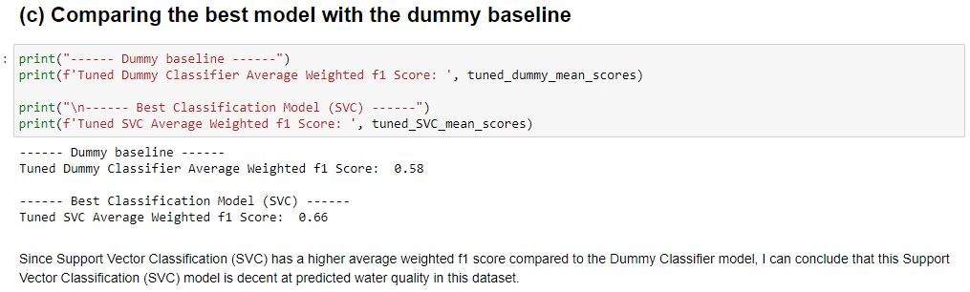
Step 4: Evaluating the result output
When comparing the best model (Tuned SVC) to the dummy classifier, the Tuned SVC has a higher accuracy compared to the dummy model. Therefore, I can conclude that this system and the Tuned SVC is working successfully.
In conclusion, the best model in this workflow will be the Tuned Support Vector Classifier (SVC) with a weighted f1 score of 0.66

Slide 19
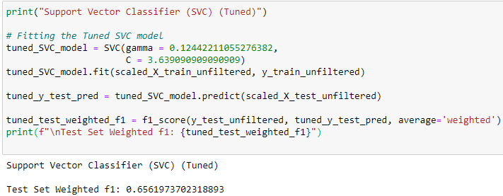
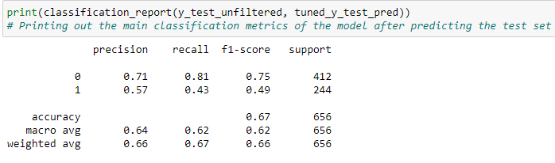

Step 5: Fitting the final model
Showing all the scoring of the Tuned SVC after it is fitted with testing set.
Final Model: Tuned SVC
The final weighted f1 score of the Tuned SVC is 0.66
Showing what values are in the Quality column (target)

Slide 20
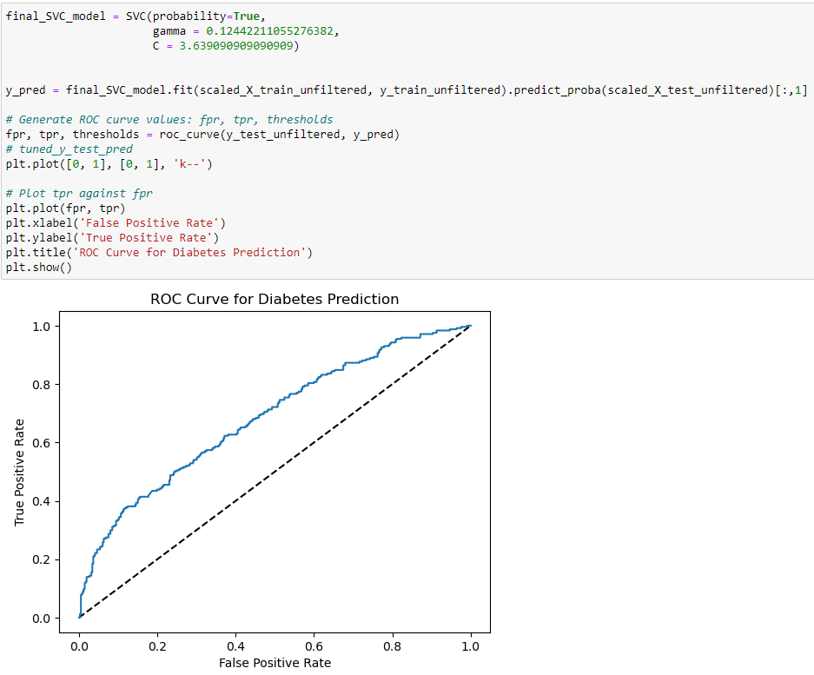
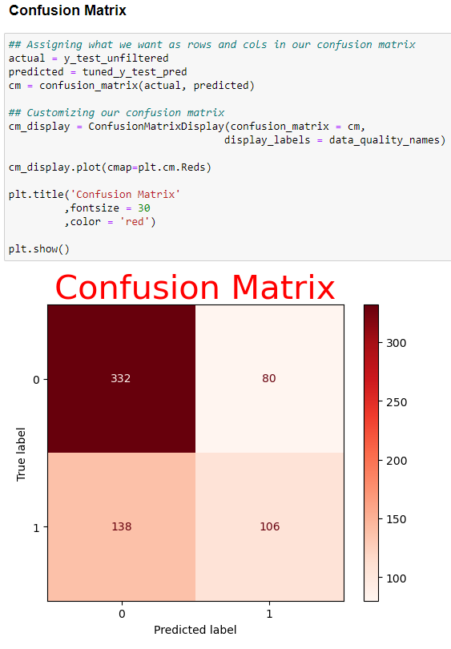
Evaluating the Tuned SVC model
Plotting the Confusion matrix to show how well the model predict the target. Showing the True Positive, False Positive, False Negative and False Negative.
ROC Curve → graph showing the performance of a classification model at all classification thresholds.
The closer the ROC Curve is to the straight line, the better the model.

